Slide 1
_{Chapter 3}
_{Data and Signals}

Slide 2

Note
To be transmitted, data must be transformed to electromagnetic signals.

Slide 3
3-1 ANALOG AND DIGITAL
Data can be analog or digital. The term analog data refers to information that is continuous; digital data refers to information that has discrete states. Analog data take on continuous values. Digital data take on discrete values.
Topics discussed in this section:
Analog and Digital Data Analog and Digital Signals Periodic and Nonperiodic Signals

Slide 4
Note
Data can be analog or digital. Analog data are continuous and take continuous values.
Digital data have discrete states and take discrete values.

Slide 5
Note
Signals can be analog or digital. Analog signals can have an infinite number of values in a range; digital signals can have only a limited number of values.

Slide 6
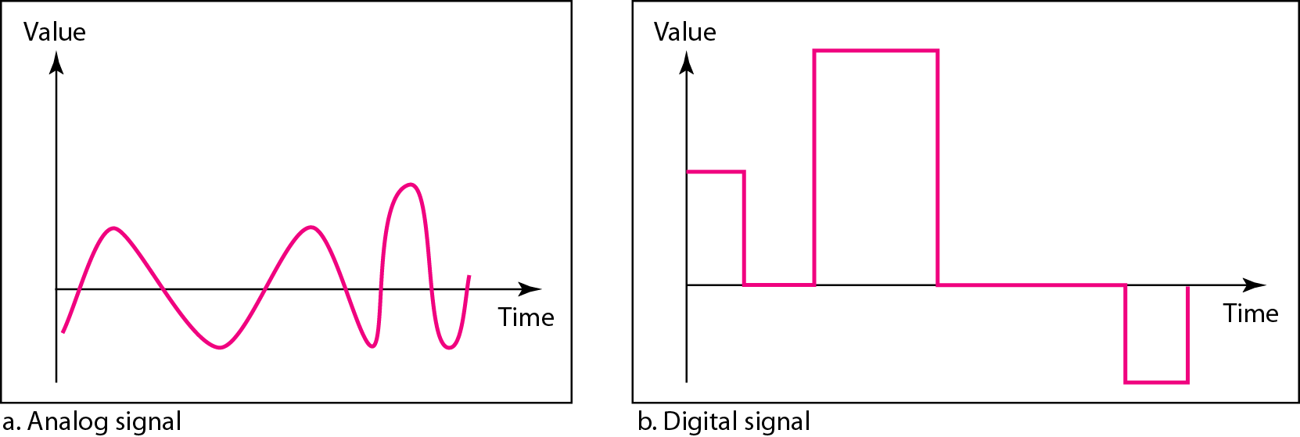
Figure 3.1 Comparison of analog and digital signals [1]

Slide 7
Note
In data communications, we commonly use periodic analog signals and nonperiodic digital signals.

Slide 8
3-2 PERIODIC ANALOG SIGNALS
Periodic analog signals can be classified as simple or composite. A simple periodic analog signal, a sine wave, cannot be decomposed into simpler signals. A composite periodic analog signal is composed of multiple sine waves.

Slide 9
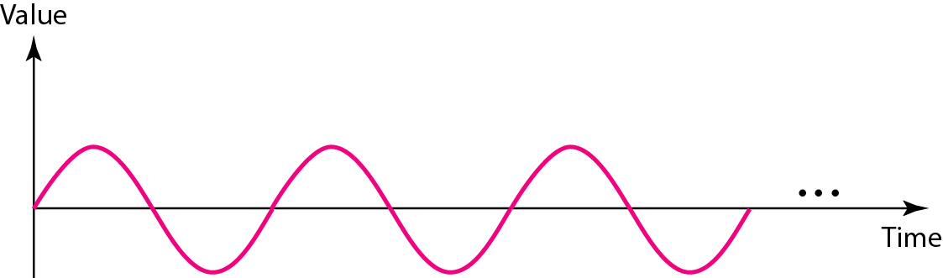
Figure 3.2 A sine wave [1]
_{s(t ) = A sin(2πft + φ)}
_{A-Amplitude}
_{2π = 360 degree =1Period}
_{φ --Phase}

Slide 10
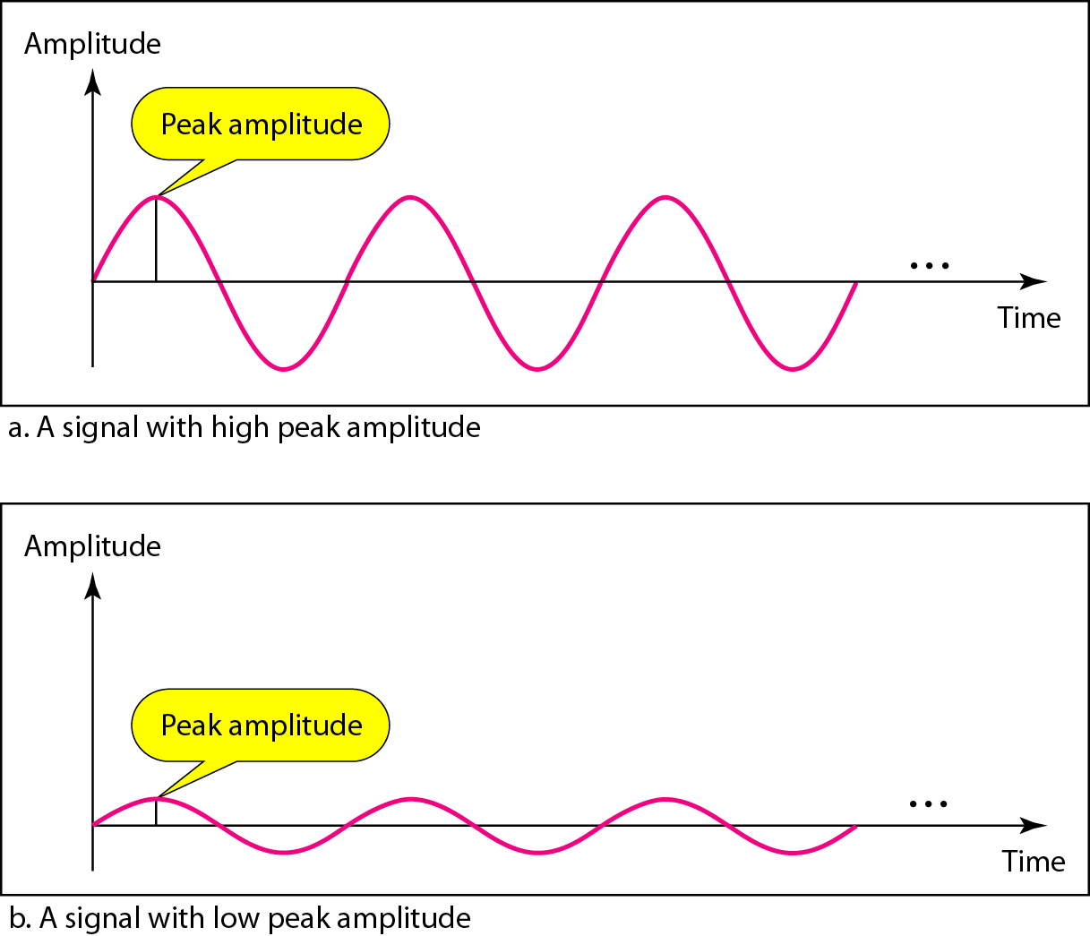
Figure 3.3 Two signals with the same phase and frequency, but different amplitudes [1]

Slide 11
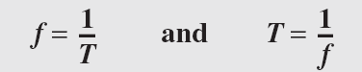
Note
Frequency and period are the inverse of each other.

Slide 12
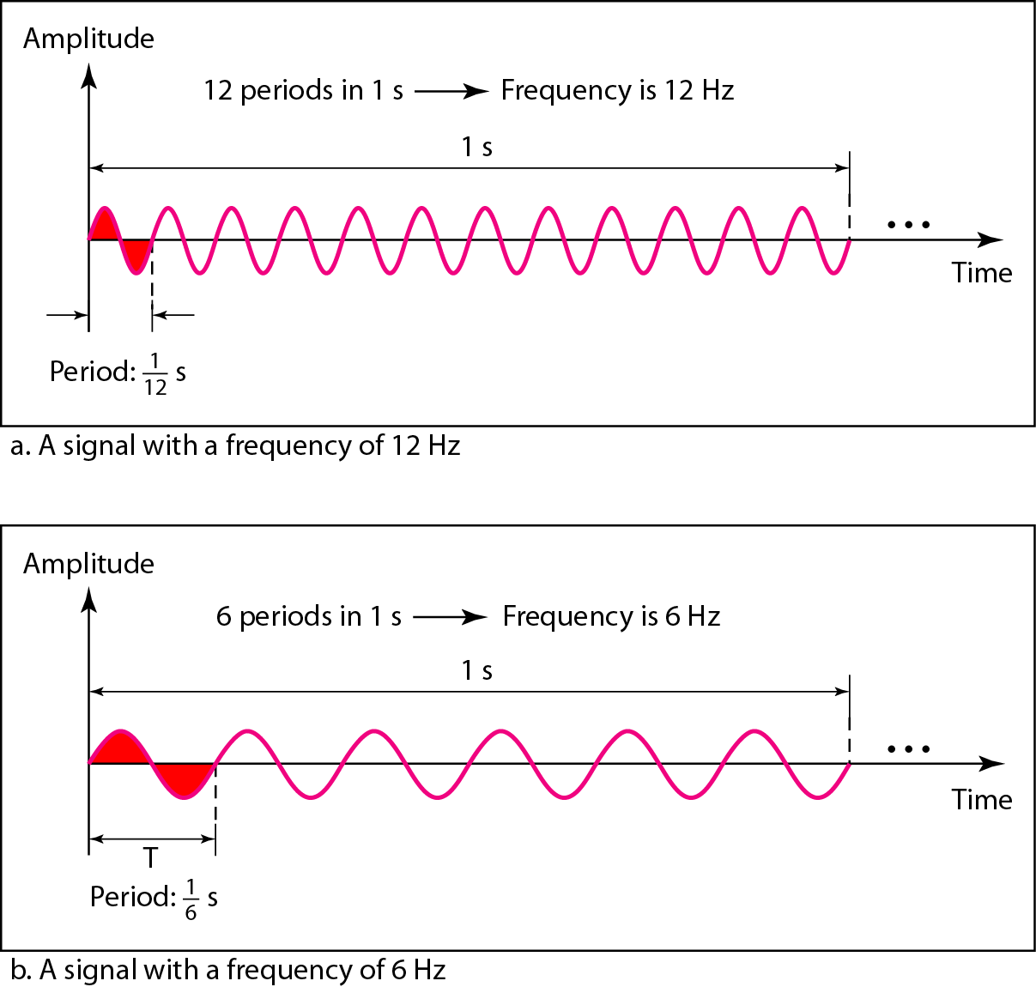
Figure 3.4 Two signals with the same amplitude and phase, but different frequencies [1]

Slide 13
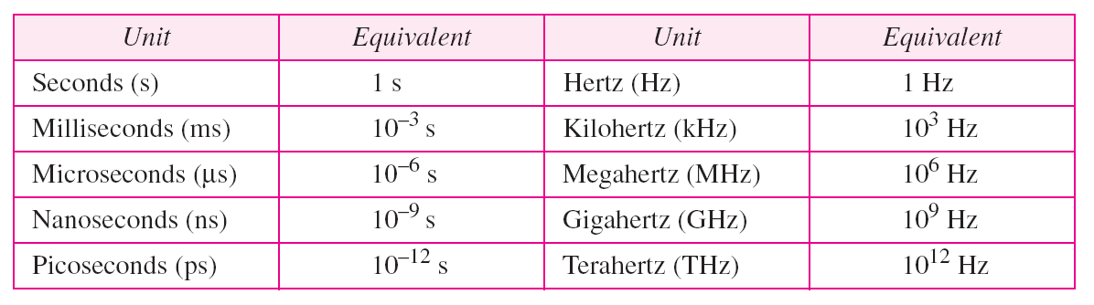
Table 3.1 Units of period and frequency [1]

Slide 14
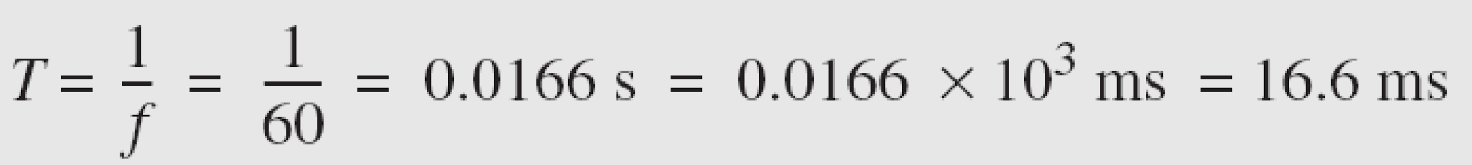
Example 3.3
The power we use at home has a frequency of 60 Hz. The period of this sine wave can be determined as follows:

Slide 15

Example 3.4
Express a period of 100 ms in microseconds.
Solution
From Table 3.1 we find the equivalents of 1 ms (1 ms is 10⁻³ s) and 1 s (1 s is 10⁶ μs). We make the following substitutions:.

Slide 16
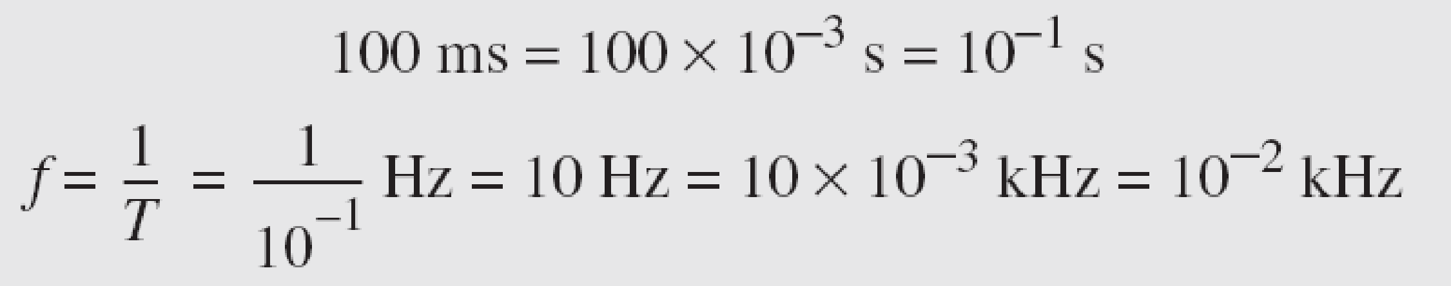
Example 3.5
The period of a signal is 100 ms. What is its frequency in kilohertz?
Solution
First we change 100 ms to seconds, and then we calculate the frequency from the period (1 Hz = 10⁻³ kHz).

Slide 17
Note
Frequency is the rate of change with respect to time. Change in a short span of time
means high frequency. Change over a long span of time means low frequency.

Slide 18
Note
If a signal does not change at all, its frequency is zero.
If a signal changes instantaneously, its frequency is infinite.

Slide 19
Note
Phase describes the position of the waveform relative to time 0.

Slide 20
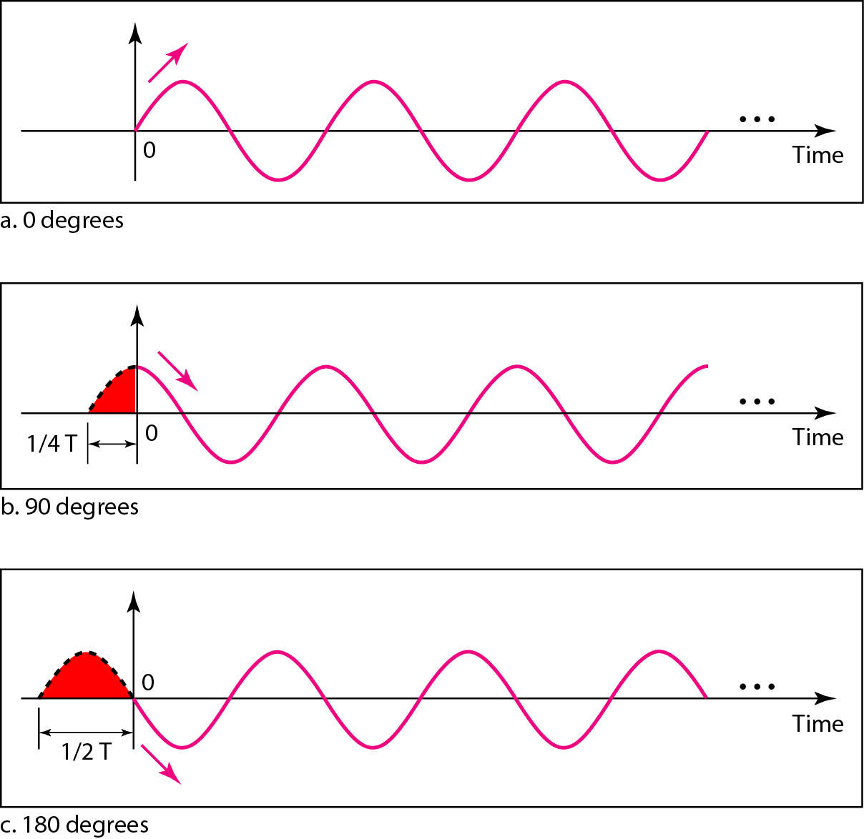
Figure 3.5 Three sine waves with the same amplitude and frequency, but different phases [1]

Slide 21
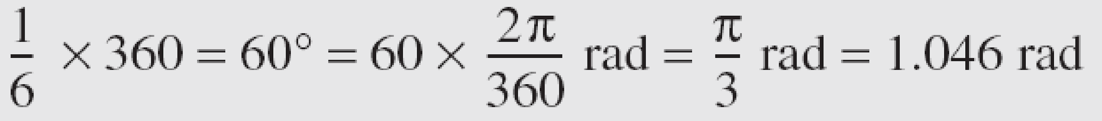
Example 3.6
A sine wave is offset 1/6 cycle with respect to time 0. What is its phase in degrees and radians?
Solution
We know that 1 complete cycle is 360°. Therefore, 1/6 cycle is

Slide 22
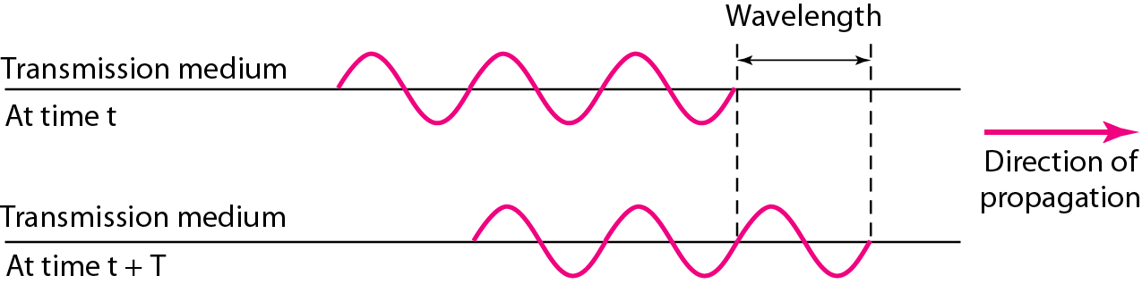
Figure 3.6 Wavelength and period [1]
The wavelength is the distance a simple signal can travel in one period.

Slide 23
Note
A complete sine wave in the time domain can be represented by one single spike in the frequency domain.

Slide 24
Note
The bandwidth of a composite signal is the difference between the
highest and the lowest frequencies contained in that signal.

Slide 25

Example 3.10
If a periodic signal is decomposed into five sine waves with frequencies of 100, 300, 500, 700, and 900 Hz, what is its bandwidth?
Solution
Let f_{h} be the highest frequency, f_{l} the lowest frequency, and B the bandwidth. Then

Slide 26
A very important consideration in data communications is how fast we can send data, in bits per second, over a channel.
Data rate depends on three factors:
1. The bandwidth available
2. The level of the signals we use
3. The quality of the channel (the level of noise)
3-5 DATA RATE LIMITS
Topics discussed in this section:
Noiseless Channel: Nyquist Bit Rate Noisy Channel: Shannon Capacity Using Both Limits

Slide 27
Noiseless Channel: Nyquist Bit Rate
For a noiseless channel, the Nyquist bit rate formula defines the theoretical maximum bit rate
BitRate = 2 x bandwidth x log₂ M
L-Levels for sending signals

Slide 28
Given a bandwidth of B, the highest signal transmission rate is 2B:
C = 2B
eg: B=3100 Hz; C=6200 bps
With multilevel signaling
C = 2B log₂ M,
where M is the number of discrete signal or voltage levels

Slide 29
Note
Increasing the levels of a signal may reduce the reliability of the system.

Slide 30

Example 3.34
Consider a noiseless channel with a bandwidth of 3000 Hz transmitting a signal with two signal levels. The maximum bit rate can be calculated as

Slide 31

Example 3.35
Consider the same noiseless channel transmitting a signal with four signal levels (for each level, we send 2 bits). The maximum bit rate can be calculated as

Slide 32
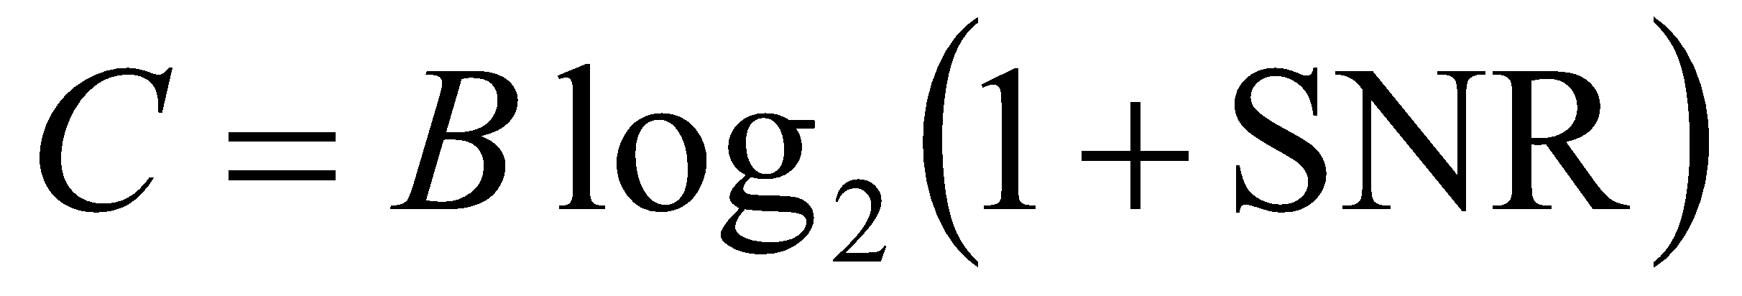
Noisy Channel: Shannon Capacity
In 1944,Claude Shannon introduced a formula, called the Shannon capacity, to determine the
theoretical highest data rate for a noisy channel:
Signal-to-noise ratio (SNR) = power of signal/power of noise
A high SNR means a high-quality signal.

Slide 33
Note
The Shannon capacity gives us the upper limit; the Nyquist formula tells us how many signal levels we need.

Slide 34
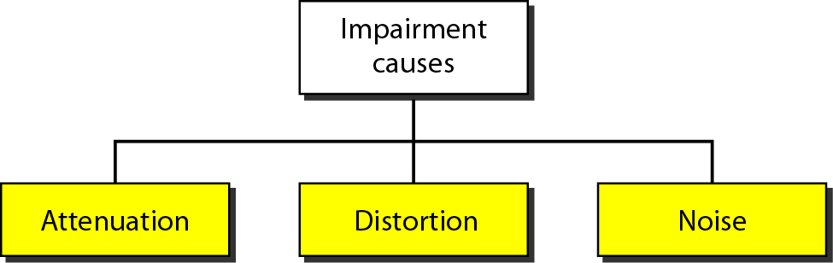
3-4 TRANSMISSION IMPAIRMENT
Signals travel through transmission media, which are not perfect.
The imperfection causes signal impairment.
This means that the signal at the beginning of the medium is not the same as the signal at the end of the medium.
What is sent is not what is received.
Three causes of impairment are attenuation, distortion, and noise.

Slide 35
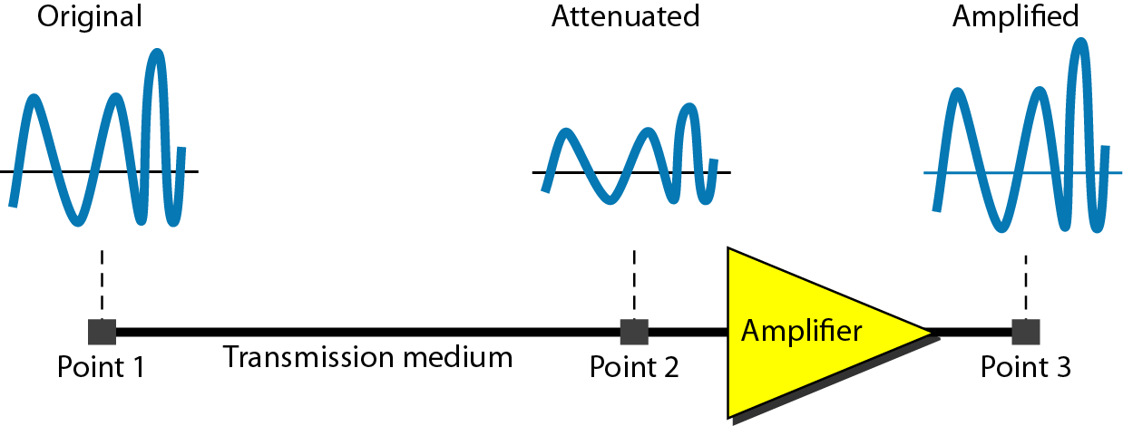
_{Attenuation}
Attenuation means a loss of energy.
it loses some of its energy in overcoming the resistance of the medium.
To compensate for this loss, amplifiers are used to amplify the signal.
_{Figure:} _{Attenuation [1]}

Slide 36
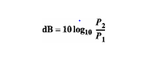
The decibel(dB) measures the relative strengths of two signals or one signal at two different points.

Slide 37
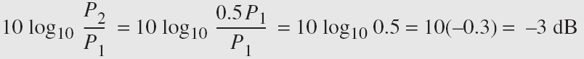
_{Example}
Suppose a signal travels through a transmission medium and its power is reduced to one-half.
_{P2= (1/2)P1.}
In this case, the attenuation (loss of power) can be calculated as
A loss of 3 dB (–3 dB) is equivalent to losing one-half the power.

Slide 38
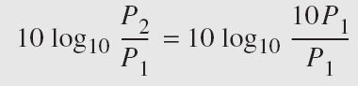
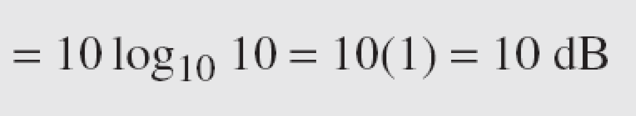
_{Example}
A signal travels through an amplifier, and its power is increased 10 times.
_{This means that P2 = 10P1 .}
What is the amplification (gain of power)?
₃₈

Slide 39
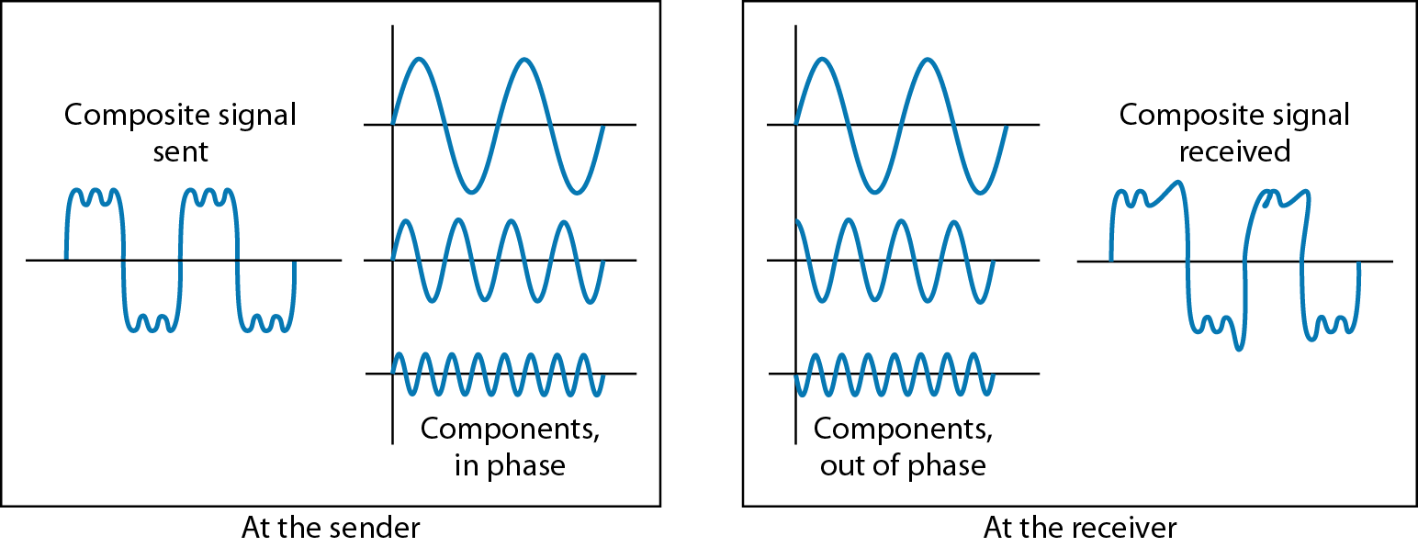
_{Distortion}
Distortion means that the signal changes its form or shape.
_{Figure: Distortion [1]}

Slide 40
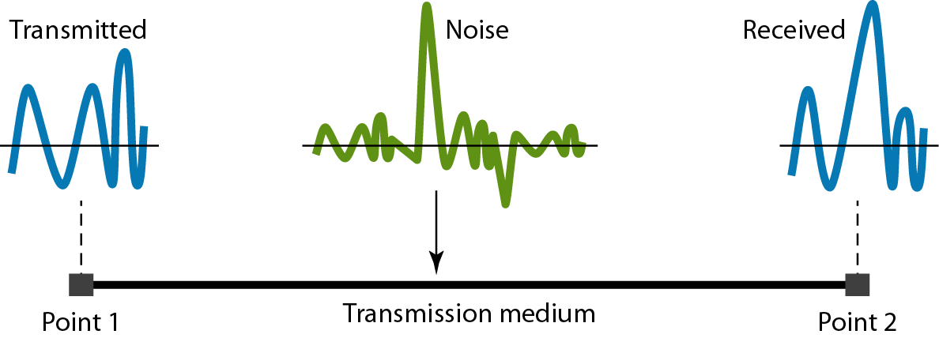
_{Noise}
Several types of noise, such as thermal noise,
induced noise, crosstalk, and impulse noise, may corrupt the signal.
_{Figure:} _{Noise [1]}

Slide 41
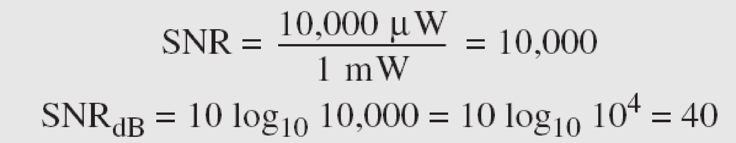
_{Example}
The power of a signal is 10 mW and the power of the noise is 1 μW; what are the values of SNR and SNRdB ?
_{Solution}
The values of SNR and SNRdB can be calculated as follows:
₄₁

Slide 42
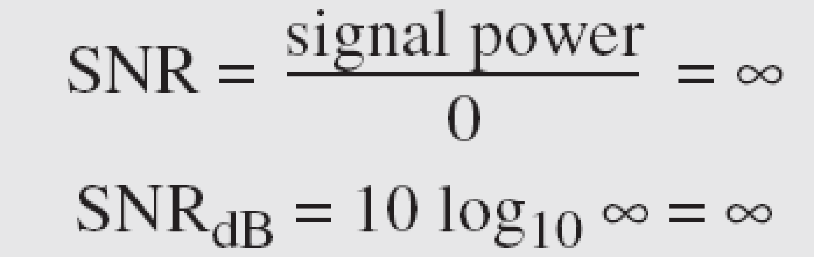
_{Example}
The values of SNR and SNRdB for a noiseless channel are
We can never achieve this ratio in real life; it is an ideal.
₄₂

Slide 43
References:
Textbooks
[1] Forouzan, Behrouz A.: “Data Communications & networking”, 4th edition TataMcgraw Hill.
[2] Tanenbaum, Andrew S: “Computer networks”, 4th Edition, Pearson education.
Reference books
[3] Stallings, William : “Data and computer communications”,8th edition,Pearson
Education.
[4] Ross, Kurose,“Computer Networking: A top down Approach”, 2nd edition, Pearson
Education.
[5] Coomer,Douglas E.: “Internet working with TCP/IP” , 2 nd edition, Pearson Education
[6] Dave,” Computer Networks, Cengage Learning.
Links:
http://eti2506.elimu.net/Introduction/Books/Data%20Communications%20and%20Networking%20By%20Behrouz%20A.Forouzan.pdf

Slide 44
5-1 DIGITAL-TO-ANALOG CONVERSION
Digital-to-analog conversion is the process of changing one of the characteristics of an analog signal based on the information in digital data.
Topics discussed in this section:
Aspects of Digital-to-Analog Conversion Amplitude Shift Keying Frequency Shift Keying
Phase Shift Keying
Quadrature Amplitude Modulation

Slide 45
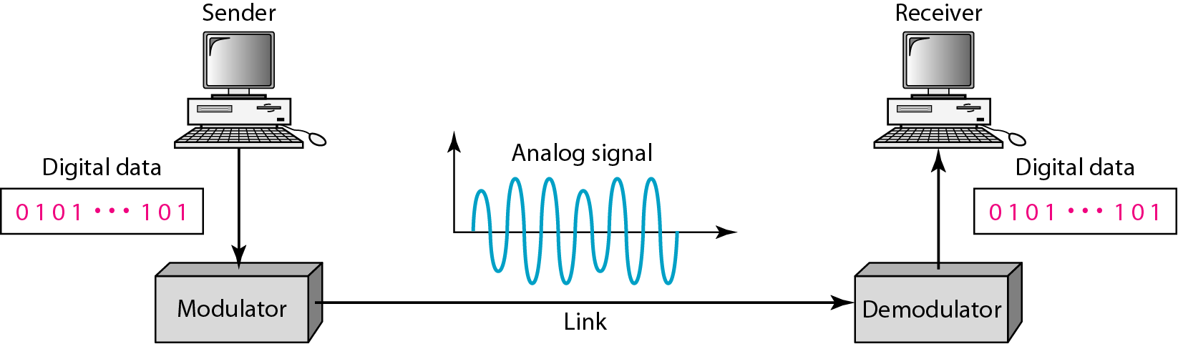
Figure 5.1 Digital-to-analog conversion [1]

Slide 46
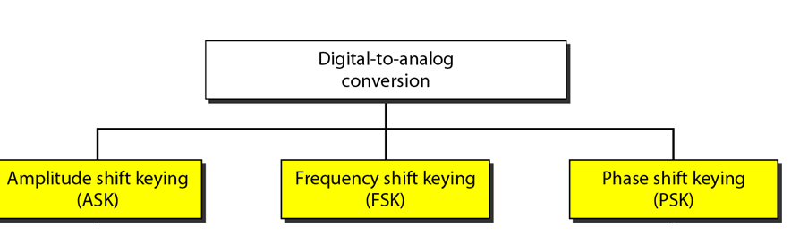
Figure 5.2 Types of digital-to-analog conversion [1]

Slide 47
Note
Bit rate is the number of bits per second. Baud rate is the number of signal
elements per second.
In the analog transmission of digital data, the baud rate is less than or equal to the bit rate.

Slide 48
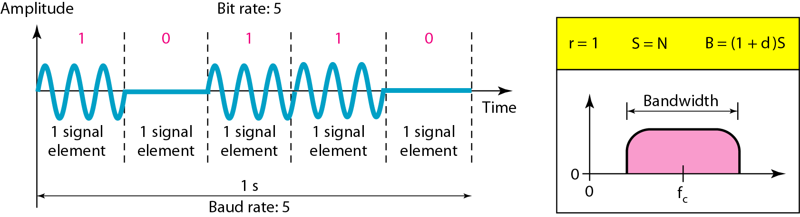
Figure 5.3 Binary amplitude shift keying [1]

Slide 49
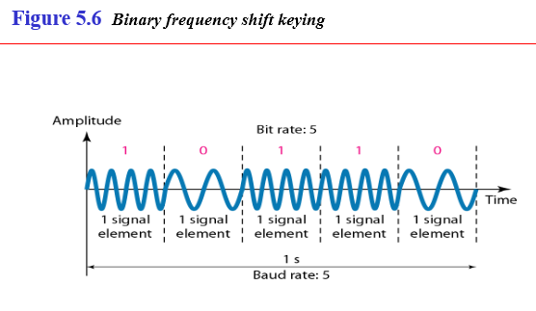

Slide 50
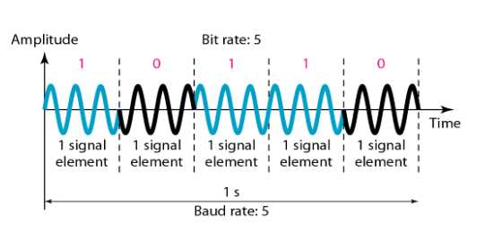
Figure 5.9 Binary phase shift keying [1]

Slide 51
Note
Quadrature amplitude modulation is a combination of ASK and PSK.

Slide 52
Note
Bandwidth utilization is the wise use of available bandwidth to achieve specific goals.
Efficiency can be achieved by multiplexing; privacy and anti-jamming can be achieved by spreading.

Slide 53
MULTIPLEXING
Whenever the bandwidth of a medium linking two devices is greater than the bandwidth needs of the devices, the link can be shared. Multiplexing is the set of techniques that allows the simultaneous transmission of multiple signals across a single data link. As data and telecommunications use increases, so does traffic.
Topics discussed in this section:
Frequency-Division Multiplexing Wavelength-Division Multiplexing Synchronous Time-Division Multiplexing
Statistical Time-Division Multiplexing

Slide 54
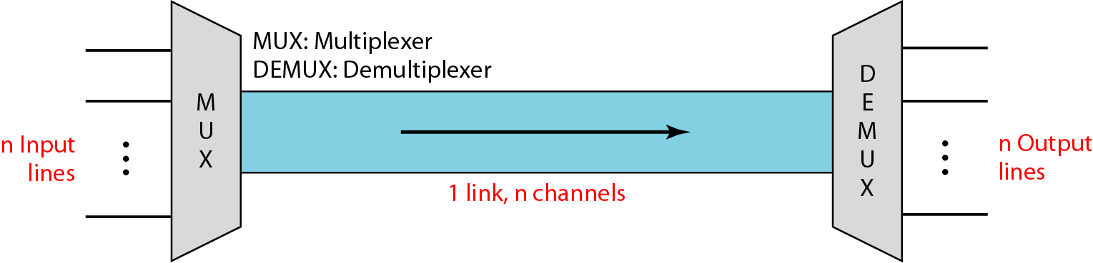
Figure Dividing a link into channels [1]

Slide 55
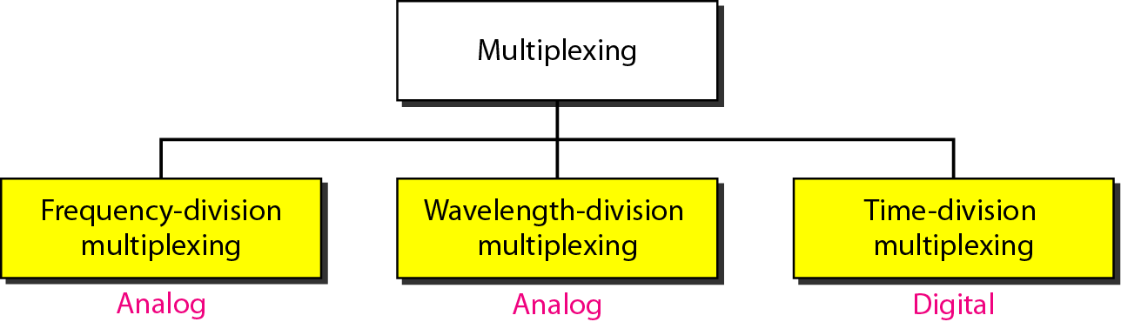
Categories of multiplexing

Slide 56
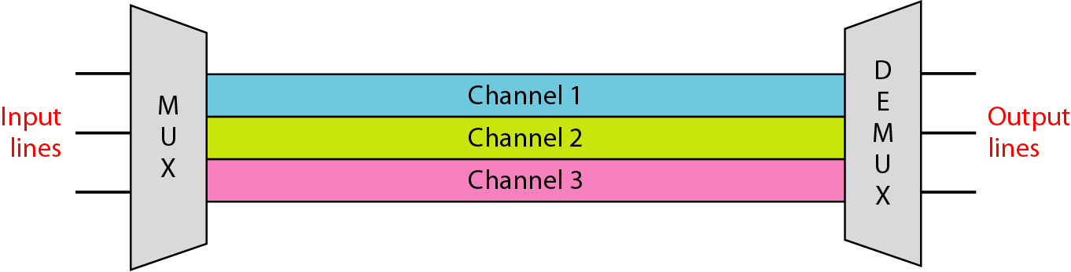
Frequency-division multiplexing [1]

Slide 57
Note
FDM is an analog multiplexing technique that combines analog signals.

Slide 58
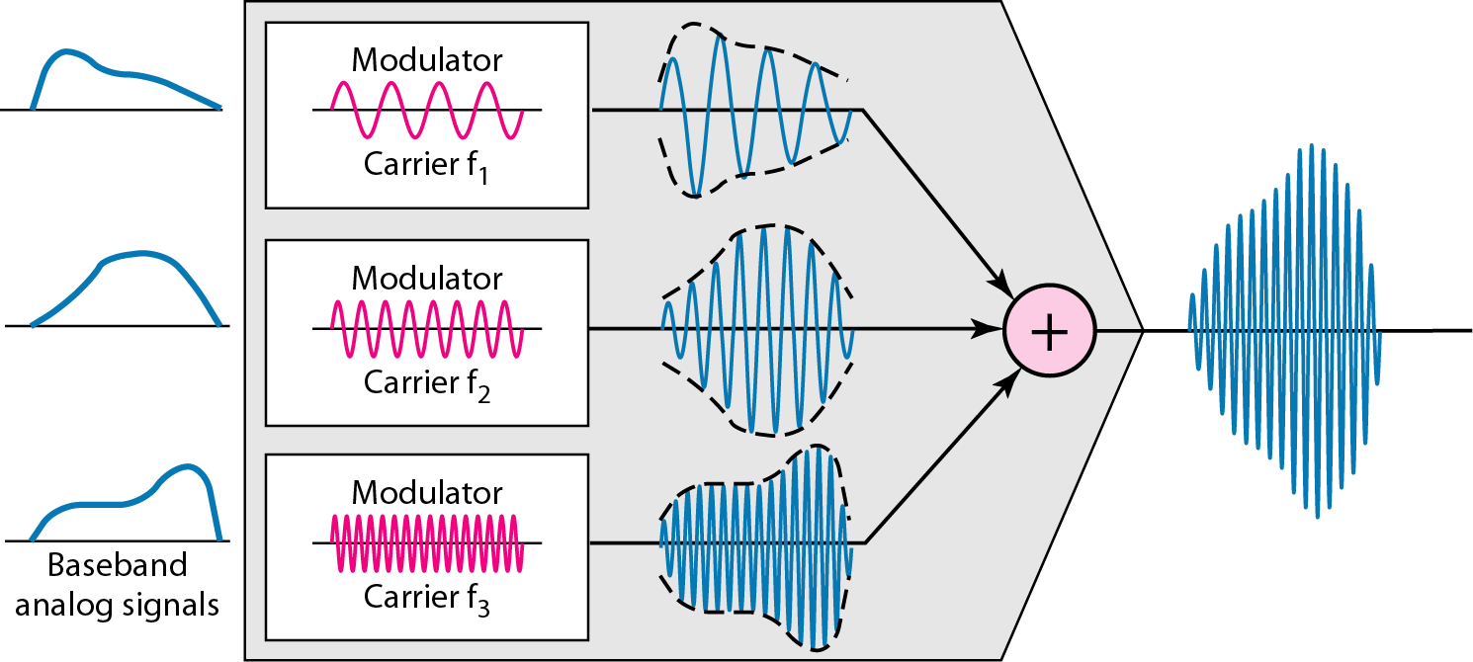
FDM process [1]

Slide 59
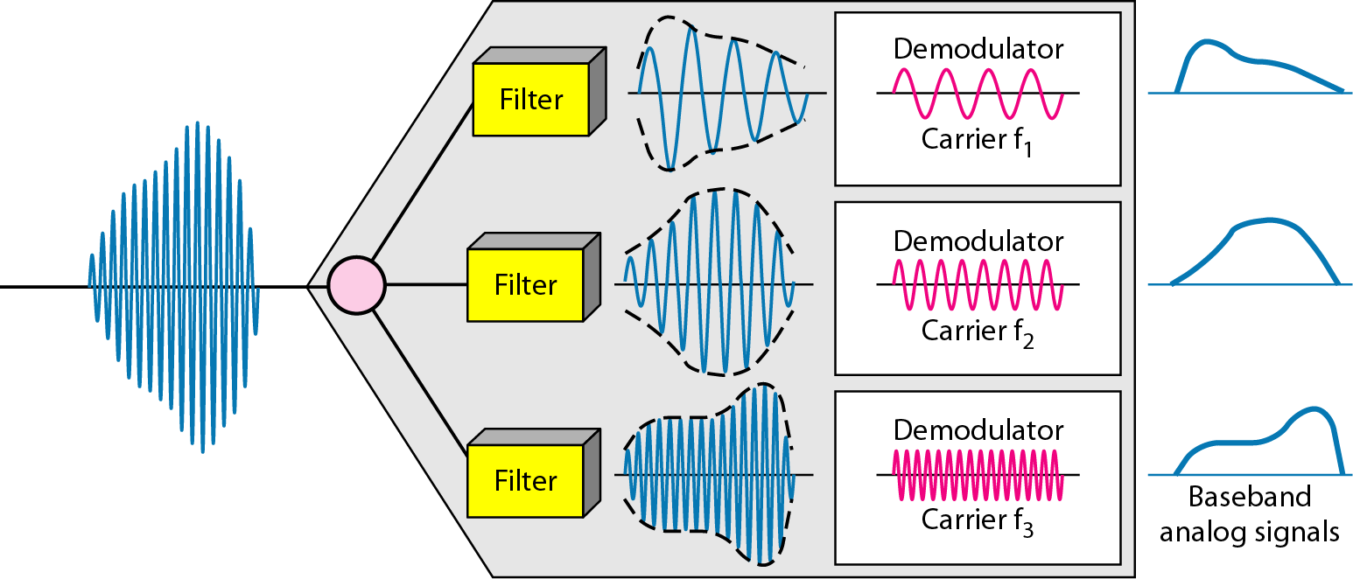
FDM demultiplexing example [1]

Slide 60
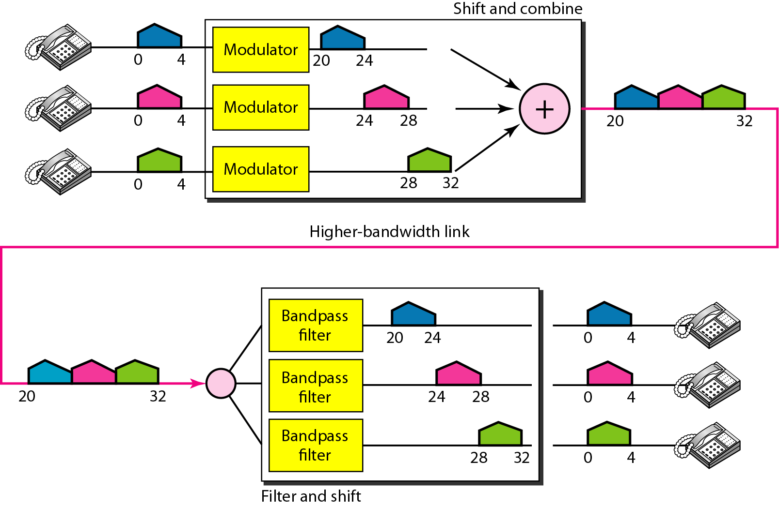
Figure 6.6 Example 6.1 [1]

Slide 61
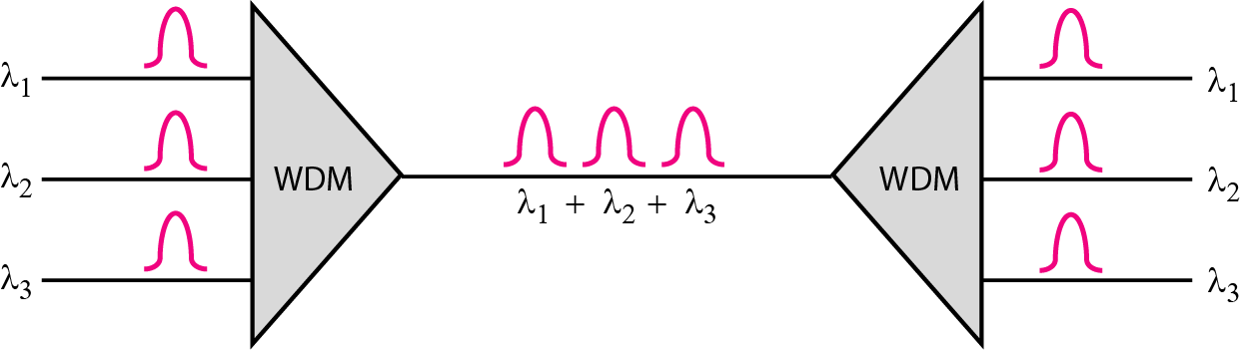
Figure 6.10 Wavelength-division multiplexing [1]

Slide 62
Note
WDM is an analog multiplexing technique to combine optical signals.

Slide 63
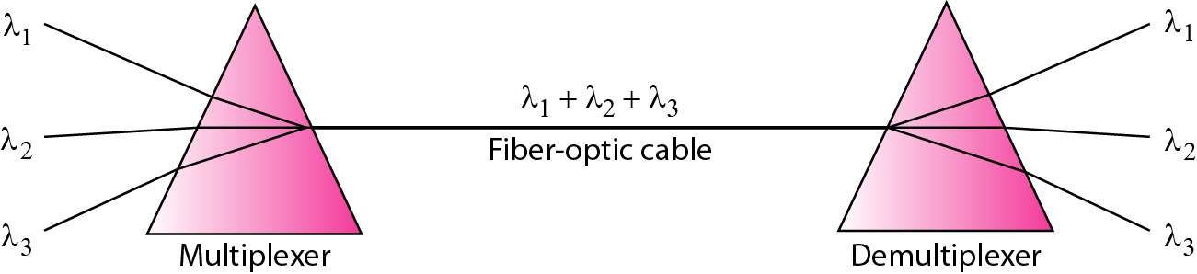
Figure 6.11 Prisms in wavelength-division multiplexing and demultiplexing [1]

Slide 64
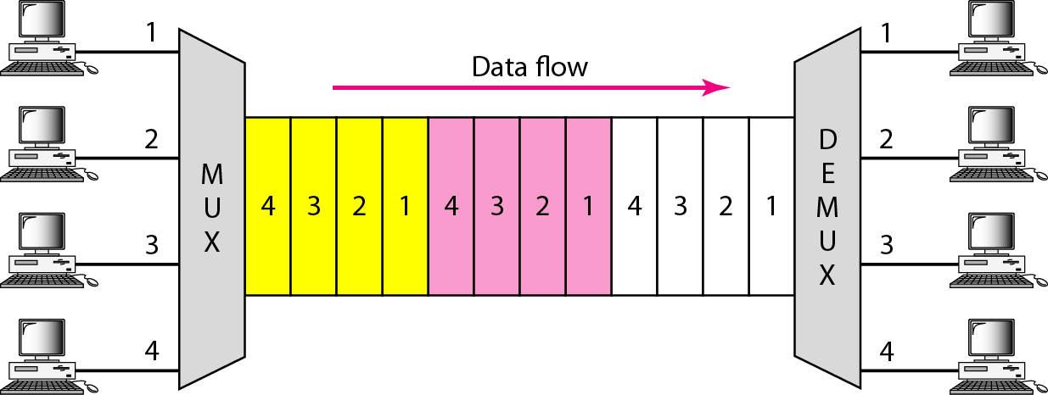
Figure 6.12 TDM [1]

Slide 65
Note
TDM is a digital multiplexing technique for combining several low-rate channels into one high-rate one.

Slide 66
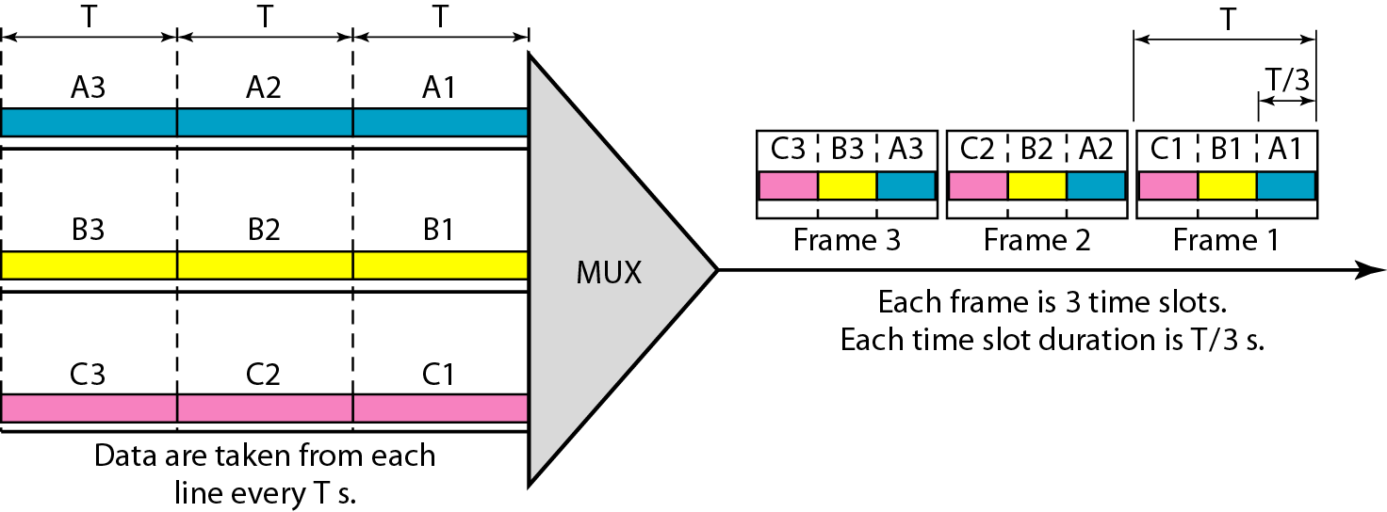
Figure 6.13 Synchronous time-division multiplexing [1]

Slide 67
Note
In synchronous TDM, the data rate of the link is n times faster, and the unit duration is n times shorter.

Slide 68
Example 6.5
In Figure 6.13, the data rate for each input connection is 3 kbps. If 1 bit at a time is multiplexed (a unit is 1 bit), what is the duration of (a) each input slot, (b) each output slot, and (c) each frame?
Solution
We can answer the questions as follows:
a. The data rate of each input connection is 1 kbps. This means that the bit duration is 1/1000 s or 1 ms. The duration of the input time slot is 1 ms (same as bit duration).

Slide 69
Example 6.5 (continued)
b. The duration of each output time slot is one-third of the input time slot. This means that the duration of the output time slot is 1/3 ms.
c. Each frame carries three output time slots. So the duration of a frame is 3 × 1/3 ms, or 1 ms. The duration of a frame is the same as the duration of an input unit.

Slide 70
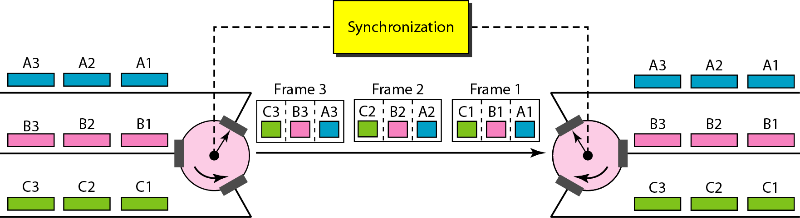
Figure 6.15 Interleaving [1]

Slide 71
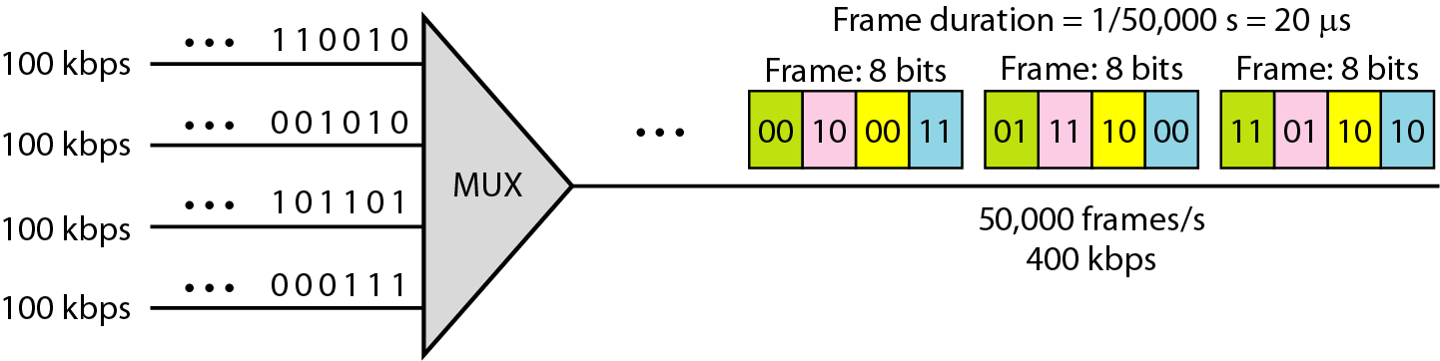

Slide 72
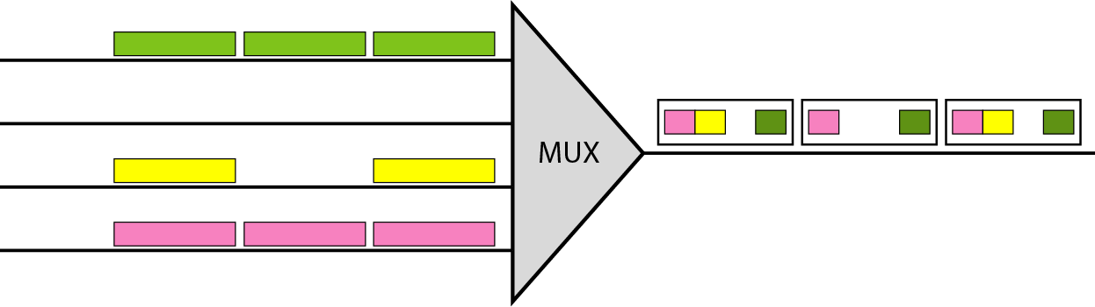
Figure 6.18 Empty slots [1]

Slide 73
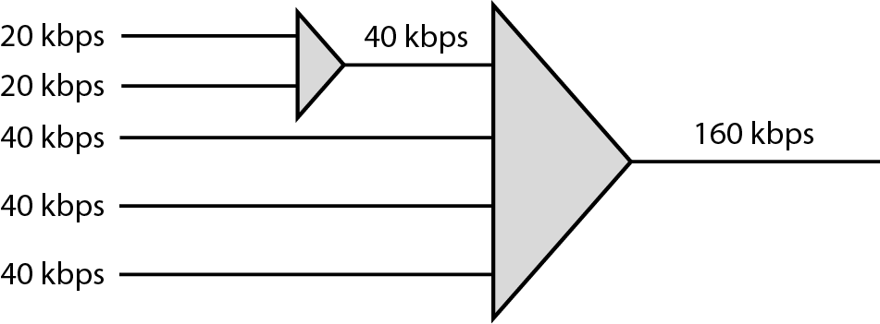
Figure 6.19 Multilevel multiplexing [1]

Slide 74
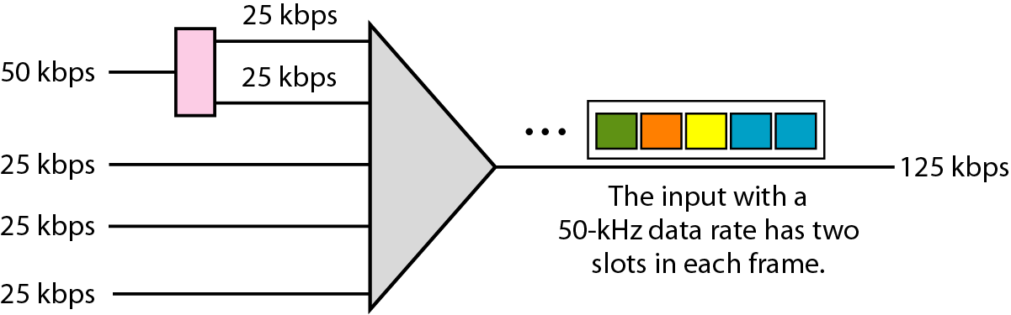
Figure 6.20 Multiple-slot multiplexing

Slide 75
References:
Textbooks
[1] Forouzan, Behrouz A.: “Data Communications & networking”, 4th edition TataMcgraw Hill.
[2] Tanenbaum, Andrew S: “Computer networks”, 4th Edition, Pearson education.
Reference books
[3] Stallings, William : “Data and computer communications”,8th edition,Pearson
Education
[4] Ross, Kurose,“Computer Networking: A top down Approach”, 2nd edition, Pearson
Education.
[5] Coomer,Douglas E.: “Internet working with TCP/IP” , 2 nd edition, Pearson Education
[6] Dave,” Computer Networks, Cengage Learning.
Links:
http://eti2506.elimu.net/Introduction/Books/Data%20Communications%20and%20Networking%20By%20Behrouz%20A.Forouzan.pdf

Slide 76
Chapter 1
Introduction

Slide 77
1-1 DATA COMMUNICATIONS
The term telecommunication means communication at a distance. The word data refers to information presented in whatever form is agreed upon by the parties creating and using the data. Data communications are the exchange of data between two devices via some form of transmission medium such as a wire cable.
Topics discussed in this section:
Components
Data Representation Data Flow

Slide 78
Five components of data communication
1. Message. The message is the information (data) to be communicated. Popular forms of information include text, numbers, pictures, audio, and video.
2. Sender. The sender is the device that sends the data message. It can be a computer, workstation, telephone handset, video camera, and so on.
3. Receiver. The receiver is the device that receives the message. It can be a computer, workstation, telephone handset, television, and so on.
4. . Transmission medium. The transmission medium is the physical path by which a message travels from sender to receiver. Some examples of transmission media include twisted-pair wire, coaxial cable, fiber-optic cable, and radio waves.
5. Protocol. A protocol is a set of rules that govern data communications. It represents an agreement between the communicating devices. Without a protocol, two devices may be connected but not communicating, just as a person speaking French cannot be understood by a person who speaks only Japanese.

Slide 79
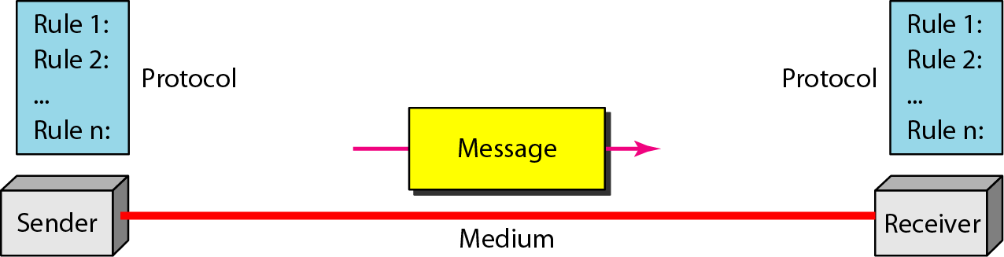
Figure 1.1 Five components of data communication
Figure 1.1 Five components of data communication [1]

Slide 80
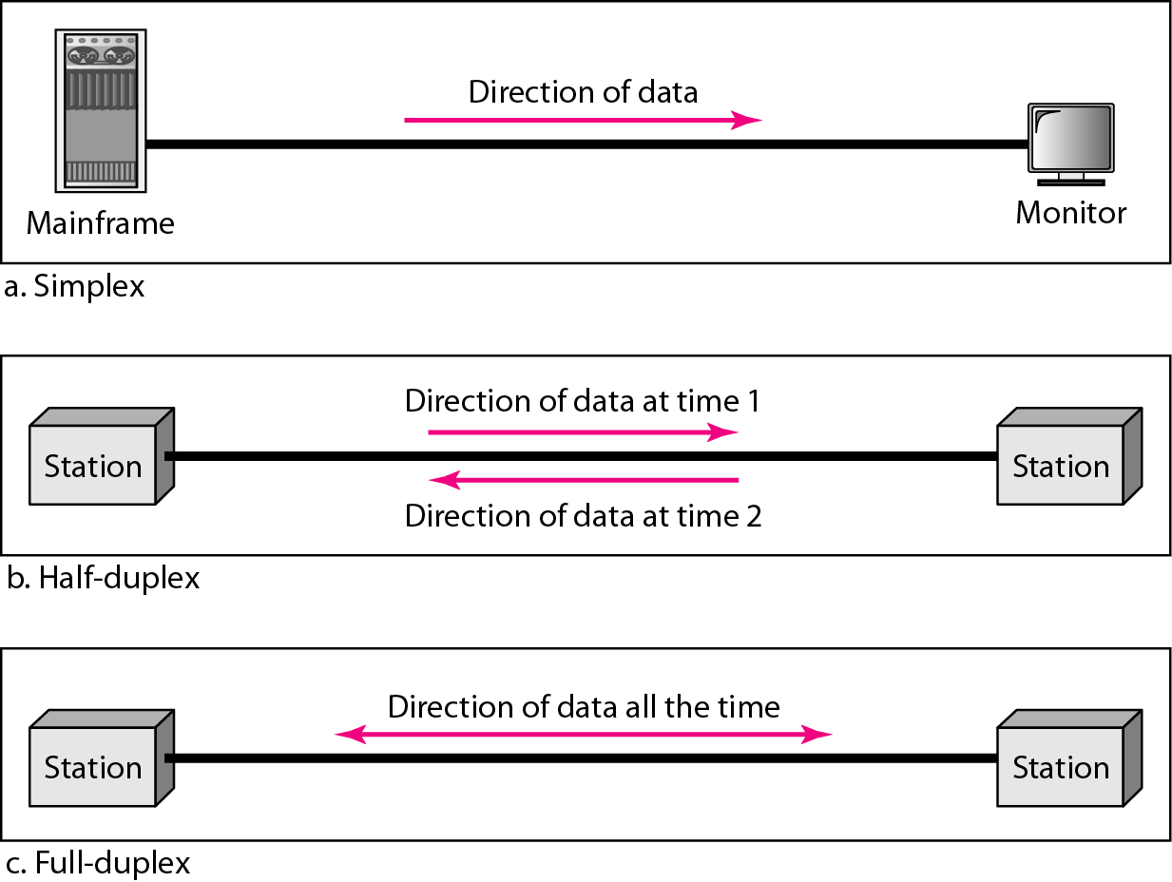
Figure 1.2 Data flow (simplex, half-duplex, and full-duplex) [1]

Slide 81
Simplex
In simplex mode, the communication is unidirectional, as on a one-way street. Only one of the two devices on a link can transmit; the other can only receive. Keyboards and traditional monitors are examples of simplex devices. The keyboard can only introduce input; the monitor can only accept output. The simplex mode can use the entire capacity of the channel to send data in one direction.
Half-Duplex
In half-duplex mode, each station can both transmit and receive, but not at the same time. When one device is sending, the other can only receive, and vice versa. The half-duplex mode is like a one-lane road with traffic allowed in both directions. When cars are traveling in one direction, cars going the other way must wait. In a half-duplex transmission, the entire capacity of a channel is taken over by whichever of
the two devices is transmitting at the time. Walkie-talkies and CB (citizens band) radios are both half-duplex systems. The half-duplex mode is used in cases where there is no need for communication in both directions at the same time; the entire capacity of the channel can be utilized for each direction.
Full-Duplex
In full-duplex mode, both stations can transmit and receive simultaneously The full-duplex mode is like a two-way street with traffic flowing in both directions at the same time. In full-duplex mode, signals going in one direction share the capacity of the link: with signals going in the other direction. This sharing can occur in
two ways: Either the link must contain two physically separate transmission paths, one for sending and the other for receiving; or the capacity of the channel is divided between signals traveling in both directions.
One common example of full-duplex communication is the telephone network. When two people are communicating by a telephone line, both can talk and listen at the same time. The full-duplex mode is used when communication in both directions is required all the time. The capacity of the channel, however, must be divided between the two directions.

Slide 82
1-2 NETWORKS
A network is a set of devices (often referred to as nodes) connected by communication links. A node can be a computer, printer, or any other device capable of sending and/or receiving data generated by other nodes on the network.
Topics discussed in this section:
Distributed Processing
Network Criteria Physical Structures Network Models Categories of Networks Interconnection of Networks: Internetwork

Slide 83
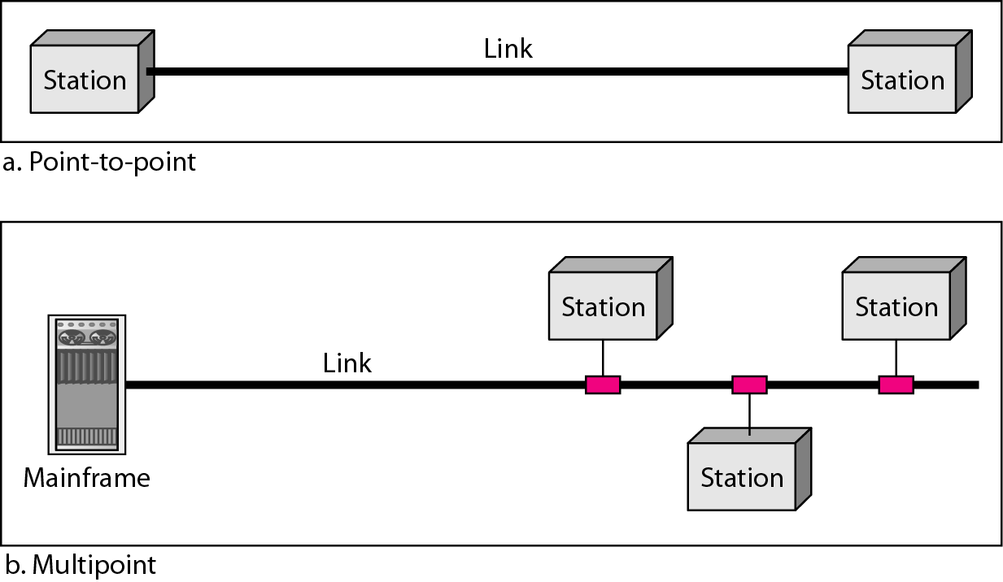
Figure 1.3 Types of connections: point-to-point and multipoint [1]

Slide 84
Types of connections: point-to-point and multipoint
Point-to-Point
A point-to-point connection provides a dedicated link between two devices. The entire capacity of the link is reserved for transmission between those two devices. Most point-to-point connections use an actual length of wire or cable to connect the two ends, but other options, such as microwave or satellite links, are also possible. When you change television channels by infrared remote control, you are establishing a point-to-point connection between the remote control and the television's control system.
Multipoint
A multipoint (also called multidrop) connection is one in which more than two specific devices share a single link.
In a multipoint environment, the capacity of the channel is shared, either spatially or temporally. If several devices can use the link simultaneously, it is a spatially shared connection. If users must take turns, it is a timeshared connection.

Slide 85
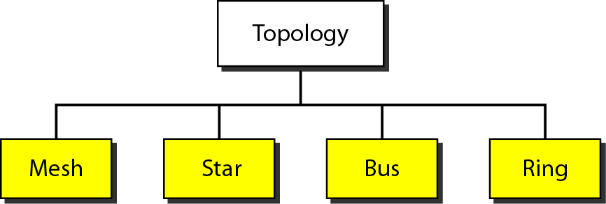
Figure 1.4 Categories of topology [1]

Slide 86
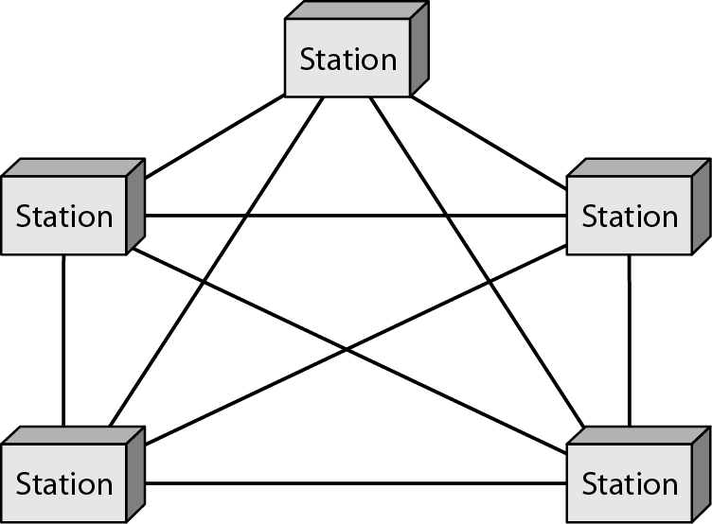
Figure 1.5 A fully connected mesh topology (five devices)
In a mesh topology, every device has a dedicated point-to-point link to every other device.
To find the number of physical links in a fully connected mesh network with n nodes, we first consider that each node must be connected to every other node. Node 1 must be connected to n - I nodes, node 2 must be connected to n – 1 nodes, and finally node n must be connected to n - 1 nodes. We need n(n - 1) physical links.
Figure 1.5 A fully connected mesh topology (five devices) [1]

Slide 87
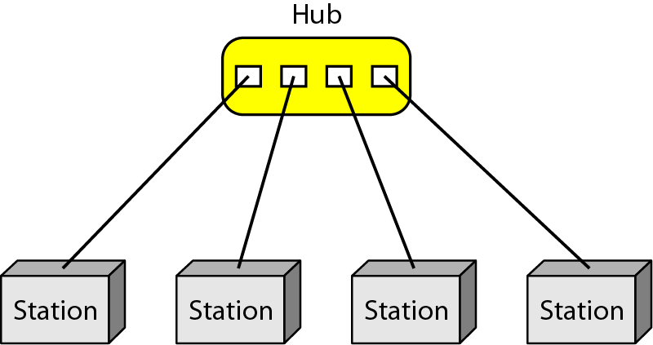
Figure 1.6 A star topology connecting four stations
In a star topology, each device has a dedicated point-to-point link only to a central controller, usually called a hub. The devices are not directly linked to one another.
A star topology is less expensive than a mesh topology. In a star, each device needs
only one link and one I/O port to connect it to any number of others. This factor also makes it easy to install and reconfigure.
Other advantages include robustness. If one link fails, only that link is affected. All other links remain active.
One big disadvantage of a star topology is the dependency of the whole topology
on one single point, the hub. If the hub goes down, the whole system is dead.
Figure 1.6 A star topology connecting four stations [1]

Slide 88
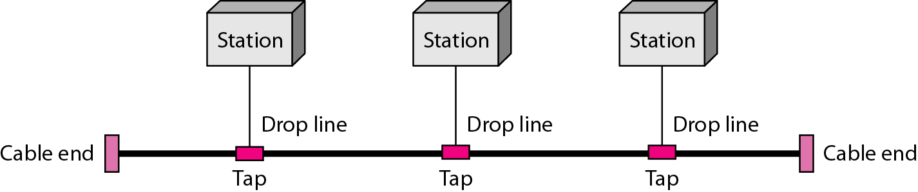
Figure 1.7 A bus topology connecting three stations [1]
Nodes are connected to the bus cable by drop lines and taps. A drop line is a connection running between the device and the main cable. A tap is a connector that either splices into the main cable or punctures the sheathing of a cable to create a contact with the metallic core.
As a signal travels along the backbone, some of its energy is transformed into heat. Therefore, it becomes weaker and weaker as it travels farther and farther. For this reason there is a limit on the number of taps a bus can support and on the distance between those taps.
Advantages of a bus topology include ease of installation.
Disadvantages include difficult reconnection and fault isolation.

Slide 89
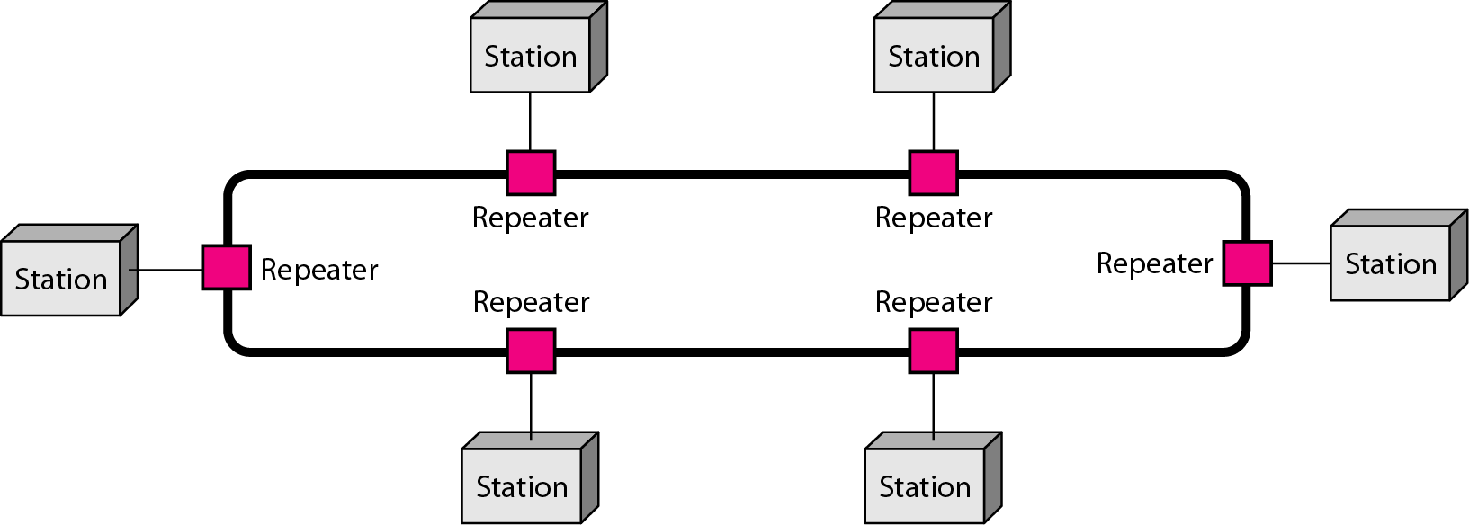
Figure 1.8 A ring topology connecting six stations [1]
In a ring topology, each device has a dedicated point-to-point connection with only the two devices on either side of it. A signal is passed along the ring in one direction, from device to device, until it reaches its destination.
A ring is relatively easy to install and reconfigure. Each device is linked to only its immediate neighbours (either physically or logically). To add or delete a device requires changing only two connections.

Slide 90

Figure 1.9 A hybrid topology: a star backbone with three bus networks [1]
A network can be hybrid. For example, we can have a main star topology with each branch connecting several stations in a bus topology.

Slide 91

Figure 1.10 An isolated LAN connecting 12 computers to a hub in a closet[1]

Slide 92

Broadcast Networks
Figure: Broadcast Networks [1]

Slide 93

Local Area Networks
LAN (Local Area Network) [1]

Slide 94

Wide Area Networks
Wide Area Network [1]
A wide area network (WAN) provides long-distance transmission of data, image, audio, and video information over large geographic areas that may comprise a country, a continent, or even the whole world.

Slide 95

Metropolitan Area Networks
metropolitan area network (MAN)
Metropolitan Area Network [1]
A metropolitan area network (MAN) is a network with a size between a LAN and a WAN. It normally covers the area inside a town or a city. It is designed for customers who need a high-speed connectivity, normally to the Internet, and have endpoints
spread over a city or part of city. A good example of a MAN is the part of the telephone company network that can provide a high-speed DSL line to the customer. Another example is the cable TV network that originally was designed for cable TV, but today can also be used for high-speed data connection to the Internet.

Slide 96

Figure 1.11 WANs: a switched WAN and a point-to-point WAN [1]

Slide 97

Figure 1.12 A heterogeneous network made of four WANs and two LANs [1]

Slide 98
1-3 THE INTERNET
The Internet has revolutionized many aspects of our daily lives. It has affected the way we do business as well as the way we spend our leisure time. The Internet is a communication system that has brought a wealth of information to our fingertips and organized it for our use.
Topics discussed in this section:
A Brief History
The Internet Today (ISPs)

Slide 99

Figure 1.13 Hierarchical organization of the Internet [1]

Slide 100
1-4 PROTOCOLS AND STANDARDS
In this section, we define two widely used terms: protocols and standards. First, we define protocol, which is synonymous with rule. Then we discuss standards, which are agreed-upon rules.
Topics discussed in this section:
Protocols Standards
Standards Organizations Internet Standards

Slide 101
Protocols
A protocol is a set of rules that govern data communications. A protocol defines what is communicated, how it is communicated, and when it is communicated. The key elements of a protocol are syntax, semantics, and timing.
Syntax. The term syntax refers to the structure or format of the data, meaning the order in which they are presented. For example, a simple protocol might expect the first 8 bits of data to be the address of the sender, the second 8 bits to be the address of the receiver, and the rest of the stream to be the message itself.
Semantics. The word semantics refers to the meaning of each section of bits. How is a particular pattern to be interpreted, and what action is to be taken based on that interpretation? For example, does an address identify the route to be taken or the final destination of the message?
Timing. The term timing refers to two characteristics: when data should be sent and how fast they can be sent. For example, if a sender produces data at 100 Mbps but the receiver can process data at only 1 Mbps, the transmission will overload the receiver and some data will be lost.

Slide 102
Standards
Standards are essential in creating and maintaining an open and competitive market for equipment manufacturers and in guaranteeing national and international interoperability of data and telecommunications technology and processes. Standards provide guidelines
to manufacturers, vendors, government agencies, and other service providers to ensure the kind of interconnectivity necessary in today's marketplace and in international communications. Data communication standards fall into two categories: de facto (meaning "by fact" or "by convention") and de jure (meaning "by law" or "by regulation").
Standards Organizations
Standards are developed through the cooperation of standards creation committees, forums, and government regulatory agencies.
International Organization for Standardization (ISO).
International Telecommunication Union-Telecommunication Standards Sector (ITU-T).
American National Standards Institute (ANSI)
Institute of Electrical and Electronics Engineers (IEEE).
Electronic Industries Association (EIA).

Slide 103
References:
Textbooks
[1]Forouzan, Behrouz A.: “Data Communications & networking”, 4th edition TataMcgraw Hill.
[2] Tanenbaum, Andrew S: “Computer networks”, 4th Edition, Pearson education.
Reference books
[3] Stallings, William : “Data and computer communications”,8th edition,Pearson
Education.
[4] Ross, Kurose,“Computer Networking: A top down Approach”, 2nd edition, Pearson
Education.
[5] Coomer,Douglas E.: “Internet working with TCP/IP” , 2 nd edition, Pearson Education
[6] Dave,” Computer Networks, Cengage Learning.
Links:
http://eti2506.elimu.net/Introduction/Books/Data%20Communications%20and%20Networking%20By%20Behrouz%20A.Forouzan.pdf

Slide 104
Switching

Slide 105

Figure 8.1 Switched network [1]

Slide 106

Figure 8.2 Taxonomy of switched networks[1]

Slide 107
8-1 CIRCUIT-SWITCHED NETWORKS
A circuit-switched network consists of a set of switches connected by physical links. A connection between two stations is a dedicated path made of one or more links. However, each connection uses only one dedicated channel on each link. Each link is normally divided into n channels by using FDM or TDM.
Topics discussed in this section:
Three Phases Efficiency Delay
Circuit-Switched Technology in Telephone Networks

Slide 108
Note
A circuit-switched network is made of a set of switches connected by physical links, in which each link is divided into n channels.

Slide 109

Figure 8.3 A trivial circuit-switched network [1]

Slide 110
Note
In circuit switching, the resources need to be reserved during the setup phase; the resources remain dedicated for the entire duration of data transfer until the teardown phase.

Slide 111
Example 8.1
As a trivial example, let us use a circuit-switched network to connect eight telephones in a small area. Communication is through 4-kHz voice channels. We assume that each link uses FDM to connect a maximum of two voice channels. The bandwidth of each link is then 8 kHz. Figure 8.4 shows the situation. Telephone 1 is connected to telephone 7; 2 to 5; 3 to 8; and 4 to 6. Of course the situation may change when new connections are made. The switch controls the connections.

Slide 112

Figure 8.4 Circuit-switched network used in Example 8.1 [1]

Slide 113
Example 8.2
As another example, consider a circuit-switched network that connects computers in two remote offices of a private company. The offices are connected using a T-1 line leased from a communication service provider. There are two 4 × 8 (4 inputs and 8 outputs) switches in this network. For each switch, four output ports are folded into the input ports to allow communication between computers in the same office. Four other output ports allow communication between the two offices. Figure 8.5 shows the situation.

Slide 114

Figure 8.5 Circuit-switched network used in Example 8.2 [1]

Slide 115

Figure 8.6 Delay in a circuit-switched network [1]

Slide 116
Note
Switching at the physical layer in the traditional telephone network uses
the circuit-switching approach.

Slide 117
8-2 DATAGRAM NETWORKS
In data communications, we need to send messages from one end system to another. If the message is going to pass through a packet-switched network, it needs to be divided into packets of fixed or variable size. The size of the packet is determined by the network and the governing protocol.
Topics discussed in this section:
Routing Table Efficiency Delay
Datagram Networks in the Internet

Slide 118
Note
In a packet-switched network, there is no resource reservation;
resources are allocated on demand.

Slide 119

A datagram network with four switches (routers) [1]

Slide 120

Routing table in a datagram network

Slide 121
Note
A switch in a datagram network uses a routing table that is based on the destination address.

Slide 122
Note
The destination address in the header of a packet in a datagram network
remains the same during the entire journey of the packet.

Slide 123

Delay in a datagram network [1]

Slide 124
Note
Switching in the Internet is done by using the datagram approach to packet switching at the network layer.

Slide 125
VIRTUAL-CIRCUIT NETWORKS
A virtual-circuit network is a cross between a circuit-switched network and a datagram network. It has some characteristics of both.
Topics discussed in this section:
Addressing Three Phases
Efficiency Delay
Circuit-Switched Technology in WANs

Slide 126

Virtual-circuit network [1]

Slide 127

Virtual-circuit identifier [1]

Slide 128

Switch and tables in a virtual-circuit network [1]

Slide 129

Source-to-destination data transfer in a virtual-circuit network

Slide 130

Setup request in a virtual-circuit network

Slide 131

Setup acknowledgment in a virtual-circuit network

Slide 132
Note
In virtual-circuit switching, all packets belonging to the same source and destination travel the same path;
but the packets may arrive at the destination with different delays if resource allocation is on demand.

Slide 133

Figure 8.16 Delay in a virtual-circuit network [1]

Slide 134
Note
Switching at the data link layer in a switched WAN is normally
implemented by using virtual-circuit techniques.

Slide 135
References:
Textbooks
[1] Forouzan, Behrouz A.: “Data Communications & networking”, 4th edition TataMcgraw Hill.
[2] Tanenbaum, Andrew S: “Computer networks”, 4th Edition, Pearson education.
Reference books
[3] Stallings, William : “Data and computer communications”,8th edition,Pearson
Education.
[4] Ross, Kurose,“Computer Networking: A top down Approach”, 2nd edition, Pearson
Education.
[5] Coomer,Douglas E.: “Internet working with TCP/IP” , 2 nd edition, Pearson Education
[6] Dave,” Computer Networks, Cengage Learning.
Links:
http://eti2506.elimu.net/Introduction/Books/Data%20Communications%20and%20Networking%20By%20Behrouz%20A.Forouzan.pdf

Slide 136
Transmission Media

Slide 137

Figure 7.1 Transmission medium and physical layer [1]

Slide 138

Figure 7.2 Classes of transmission media [1]

Slide 139
7-1 GUIDED MEDIA
Guided media, which are those that provide a conduit from one device to another, include twisted-pair cable, coaxial cable, and fiber-optic cable.
Topics discussed in this section:
Twisted-Pair Cable Coaxial Cable Fiber-Optic Cable

Slide 140

Figure 7.3 Twisted-pair cable [1]

Slide 141


Slide 142

Figure 7.4 UTP and STP cables [1]

Slide 143

Table 7.1 Categories of unshielded twisted-pair cables [1]

Slide 144

Figure 7.7 Coaxial cable [1]

Slide 145

Figure 7.10 Bending of light ray [1]

Slide 146

Figure 7.11 Optical fiber [1]

Slide 147

Figure 7.12 Propagation modes [1]

Slide 148

Figure 7.13 Modes [1]

Slide 149

Figure 7.15 Fiber-optic cable connectors [1]

Slide 150
7-2 UNGUIDED MEDIA: WIRELESS
Unguided media transport electromagnetic waves without using a physical conductor. This type of communication is often referred to as wireless communication.
Topics discussed in this section:
Radio Waves
Microwaves
Infrared

Slide 151

Figure 7.17 Electromagnetic spectrum for wireless communication [1]

Slide 152

Figure 7.18 Propagation methods [1]

Slide 153

Table 7.4 Bands

Slide 154

Figure 7.19 Wireless transmission waves [1]

Slide 155

Figure 7.20 Omnidirectional antenna [1]

Slide 156
Note
Radio waves are used for multicast communications, such as radio and television, and paging systems.

Slide 157

Figure 7.21 Unidirectional antennas [1]

Slide 158
Note
Microwaves are used for unicast communication such as cellular telephones, satellite networks, and wireless LANs.

Slide 159
Note
Infrared signals can be used for short-range communication in a closed area using line-of-sight propagation.

Slide 160
References:
Textbooks
[1] Forouzan, Behrouz A.: “Data Communications & networking”, 4th edition TataMcgraw Hill.
[2]Tanenbaum, Andrew S: “Computer networks”, 4th Edition, Pearson education.
Reference books
[3]Stallings, William : “Data and computer communications”,8th edition,Pearson
Education.
[4] Ross, Kurose,“Computer Networking: A top down Approach”, 2nd edition, Pearson
Education.
[5] Coomer,Douglas E.: “Internet working with TCP/IP” , 2 nd edition, Pearson Education
[6] Dave,” Computer Networks, Cengage Learning.
Links:
http://eti2506.elimu.net/Introduction/Books/Data%20Communications%20and%20Networking%20By%20Behrouz%20A.Forouzan.pdf

Slide 161
LAB-1
​Prepare cross-wired cable and straight through cable.
​Module Objective: Explain how physical layer protocols, services, and network media support communications across data networks.​

Slide 162
Purpose of the Physical Layer​ The Physical Connection​
Before any network communications can occur, a physical connection to a local network must be established.
This connection could be wired or wireless, depending on the setup of the network.
This generally applies whether you are considering a corporate office or a home.
A Network Interface Card (NIC) connects a device to the network.
Some devices may have just one NIC, while others may have multiple NICs (Wired and/or Wireless, for example).
Not all physical connections offer the same level of performance.

Slide 163

Purpose of the Physical Layer The Physical Layer
Transport bits across the network media
Accepts a complete frame from the Data Link Layer and encodes it as a series of signals that are transmitted to the local media.
This is the last step in the encapsulation process.
The next device in the path to the destination receives the bits and re-encapsulates the frame, then decides what to do with it.

Slide 164

Physical Layer Characteristics Physical Layer Standards

Slide 165
Physical Layer Characteristics Physical Components
Physical Layer Standards address three functional areas:
Physical Components
Encoding
Signaling
The Physical Components are the hardware devices, media, and other connectors that transmit the signals that represent the bits.
Hardware components like NICs, interfaces and connectors, cable materials, and cable designs are all specified in standards associated with the physical layer.

Slide 166

Physical Layer Characteristics Encoding
Encoding converts the stream of bits into a format recognizable by the next device in the network path.
This ‘coding’ provides predictable patterns that can be recognized by the next device.
Examples of encoding methods include Manchester (shown in the figure), 4B/5B, and 8B/10B.

Slide 167


Physical Layer Characteristics Signaling
The signaling method is how the bit values, “1” and “0” are represented on the physical medium.
The method of signaling will vary based on the type of medium being used.

Slide 168

Physical Layer Characteristics Bandwidth
Bandwidth is the capacity at which a medium can carry data.
Digital bandwidth measures the amount of data that can flow from one place to another in a given amount of time; how many bits can be transmitted in a second.

Slide 169
Physical Layer Characteristics Bandwidth Terminology
Latency
Amount of time, including delays, for data to travel from one given point to another
Throughput
The measure of the transfer of bits across the media over a given period of time
Goodput
The measure of usable data transferred over a given period of time.
Goodput = Throughput - traffic overhead

Slide 170
Copper Cabling Characteristics of Copper Cabling
Copper cabling is the most common type of cabling used in networks today. It is inexpensive, easy to install, and has low resistance to electrical current flow.
Limitations:
Attenuation – the longer the electrical signals have to travel, the weaker they get.
The electrical signal is susceptible to interference from two sources, which can distort and corrupt the data signals (Electromagnetic Interference (EMI) and Radio Frequency Interference (RFI) and Crosstalk).
Mitigation:
Strict adherence to cable length limits will mitigate attenuation.
Some kinds of copper cable mitigate EMI and RFI by using metallic shielding and grounding.
Some kinds of copper cable mitigate crosstalk by twisting opposing circuit pair wires together.

Slide 171

Copper Cabling Types of Copper Cabling

Slide 172

Copper Cabling Unshielded Twisted Pair (UTP)
UTP is the most common networking media.​
Terminated with RJ-45 connectors​
Interconnects hosts with intermediary network devices.​
Key Characteristics of UTP​
The outer jacket protects the copper wires from physical damage.​
Twisted pairs protect the signal from interference.​
Color-coded plastic insulation electrically isolates the wires from each other and identifies each pair.​

Slide 173

Copper Cabling Shielded Twisted Pair (STP)
Better noise protection than UTP​
More expensive than UTP​
Harder to install than UTP​
Terminated with RJ-45 connectors​
Interconnects hosts with intermediary network devices​
Key Characteristics of STP:
The outer jacket protects the copper wires from physical damage
Braided or foil shield provides EMI/RFI protection
Foil shield for each pair of wires provides EMI/RFI protection
Color-coded plastic insulation electrically isolates the wires from each other and identifies each pair

Slide 174
Copper Cabling Coaxial Cable
Consists of the following:
Outer cable jacket to prevent minor physical damage
A woven copper braid, or metallic foil, acts as the second wire in the circuit and as a shield for the inner conductor.
A layer of flexible plastic insulation.
A copper conductor is used to transmit the electronic signals.
There are different types of connectors used with coax cable.
Commonly used in the following situations:
Wireless installations - attach antennas to wireless devices
Cable internet installations - customer premises wiring

Slide 175

Copper Cabling Coaxial Cable

Slide 176

UTP Cabling Properties of UTP Cabling
UTP has four pairs of color-coded copper wires twisted together and encased in a flexible plastic sheath. No shielding is used. UTP relies on the following properties to limit crosstalk:
Cancellation - Each wire in a pair of wires uses opposite polarity. One wire is negative, the other wire is positive. They are twisted together and the magnetic fields effectively cancel each other and outside EMI/RFI.
Variation in twists per foot in each wire - Each wire is twisted a different amount, which helps prevent crosstalk amongst the wires in the cable.

Slide 177

UTP Cabling UTP Cabling Standards and Connectors
Standards for UTP are established by the TIA/EIA. TIA/EIA-568 standardizes elements like:
Cable Types
Cable Lengths
Connectors
Cable Termination
Testing Methods
Electrical standards for copper cabling are established by the IEEE, which rates cable according to its performance. Examples include:
Category 3
Category 5 and 5e
Category 6

Slide 178

UTP Cabling UTP Cabling Standards and Connectors (Cont.)

Slide 179

UTP Cabling Straight-through and Crossover UTP Cables

Slide 180
Fiber-Optic Cabling Properties of Fiber-Optic Cabling
Not as common as UTP because of the expense involved
Ideal for some networking scenarios
Transmits data over longer distances at higher bandwidth than any other networking media
Less susceptible to attenuation, and completely immune to EMI/RFI
Made of flexible, extremely thin strands of very pure glass
Uses a laser or LED to encode bits as pulses of light
The fiber-optic cable acts as a wave guide to transmit light between the two ends with minimal signal loss

Slide 181

Fiber-Optic Cabling Types of Fiber Media
Dispersion refers to the spreading out of a light pulse over time. Increased dispersion means increased loss of signal strength. MMF has greater dispersion than SMF, with the maximum cable distance for MMF is 550 meters.​

Slide 182
Fiber-Optic Cabling Fiber-Optic Cabling Usage
Fiber-optic cabling is now being used in four types of industry:
Enterprise Networks - Used for backbone cabling applications and interconnecting infrastructure devices
Fiber-to-the-Home (FTTH) - Used to provide always-on broadband services to homes and small businesses
Long-Haul Networks - Used by service providers to connect countries and cities
Submarine Cable Networks - Used to provide reliable high-speed, high-capacity solutions capable of surviving in harsh undersea environments at up to transoceanic distances.

Slide 183

Fiber-Optic Cabling Fiber-Optic Connectors

Slide 184

Fiber-Optic Cabling Fiber Patch Cords
A yellow jacket is for single-mode fiber cables and orange (or aqua) for multimode fiber cables.​

Slide 185

Fiber-Optic Cabling Fiber versus Copper
Optical fiber is primarily used as backbone cabling for high-traffic, point-to-point connections between data distribution facilities and for the interconnection of buildings in multi-building campuses.

Slide 186
Wireless Media Properties of Wireless Media
It carries electromagnetic signals representing binary digits using radio or microwave frequencies. This provides the greatest mobility option. Wireless connection numbers continue to increase.
Some of the limitations of wireless:
Coverage area - Effective coverage can be significantly impacted by the physical characteristics of the deployment location.
Interference - Wireless is susceptible to interference and can be disrupted by many common devices.
Security - Wireless communication coverage requires no access to a physical strand of media, so anyone can gain access to the transmission.
Shared medium - WLANs operate in half-duplex, which means only one device can send or receive at a time. Many users accessing the WLAN simultaneously results in reduced bandwidth for each user.

Slide 187
Wireless Media Types of Wireless Media
The IEEE and telecommunications industry standards for wireless data communications
cover both the data link and physical layers. In each of these standards, physical layer
specifications dictate:
Data to radio signal encoding methods
Frequency and power of transmission
Signal reception and decoding requirements
Antenna design and construction
Wireless Standards:
Wi-Fi (IEEE 802.11) - Wireless LAN (WLAN) technology
Bluetooth (IEEE 802.15) - Wireless Personal Area network (WPAN) standard
WiMAX (IEEE 802.16) - Uses a point-to-multipoint topology to provide broadband wireless access
Zigbee (IEEE 802.15.4) - Low data-rate, low power-consumption communications, primarily for Internet of Things (IoT) applications

Slide 188
Wireless Media Wireless LAN
In general, a Wireless LAN (WLAN) requires the following devices:
Wireless Access Point (AP) - Concentrate wireless signals from users and connect to the existing copper-based network infrastructure
Wireless NIC Adapters - Provide wireless communications capability to network hosts
There are a number of WLAN standards. When purchasing WLAN equipment, ensure compatibility, and interoperability.
Network Administrators must develop and apply stringent security policies and processes to protect WLANs from unauthorized access and damage.

Slide 189
Chapter 2
Network Models

Slide 190
2-1 LAYERED TASKS
We use the concept of layers in our daily life. As an example, let us consider two friends who communicate through postal mail. The process of sending a letter to a friend would be complex if there were no services available from the post office.
Topics discussed in this section:
Sender, Receiver, and Carrier Hierarchy

Slide 191

Figure 2.1 Tasks involved in sending a letter [1]

Slide 192
2-2 THE OSI MODEL
Established in 1947, the International Standards Organization (ISO) is a multinational body dedicated to worldwide agreement on international standards. An ISO standard that covers all aspects of network communications is the Open Systems Interconnection (OSI) model. It was first introduced in the late 1970s.
Topics discussed in this section:
Layered Architecture Peer-to-Peer Processes
Encapsulation

Slide 193
Note
ISO is the organization. OSI is the model.

Slide 194

Figure 2.2 Seven layers of the OSI model [1]

Slide 195

Figure 2.3 The interaction between layers in the OSI model [1]

Slide 196

Figure 2.4 An exchange using the OSI model [1]

Slide 197
2-3 LAYERS IN THE OSI MODEL
In this section we briefly describe the functions of each layer in the OSI model.
Topics discussed in this section:
Physical Layer Data Link Layer
Network Layer
Transport Layer
Session Layer
Presentation Layer
Application Layer

Slide 198

Figure 2.5 Physical layer [1]

Slide 199
Note
The physical layer is responsible for movements of
individual bits from one hop (node) to the next.

Slide 200

Figure 2.6 Data link layer [1]

Slide 201
Note
The data link layer is responsible for moving frames from one hop (node) to the next.

Slide 202

Figure 2.7 Hop-to-hop delivery [1]

Slide 203

Figure 2.8 Network layer [1]

Slide 204
Note
The network layer is responsible for the delivery of individual packets from
the source host to the destination host.

Slide 205

Figure 2.9 Source-to-destination delivery [1]

Slide 206

Figure 2.10 Transport layer [1]

Slide 207
Note
The transport layer is responsible for the delivery of a message from one process to another.

Slide 208

Figure 2.11 Reliable process-to-process delivery of a message [1]

Slide 209

Figure 2.12 Session layer [1]

Slide 210
Note
The session layer is responsible for dialog control and synchronization.

Slide 211

Figure 2.13 Presentation layer [1]

Slide 212
Note
The presentation layer is responsible for translation, compression, and encryption.

Slide 213

Figure 2.14 Application layer [1]

Slide 214
Note
The application layer is responsible for providing services to the user.

Slide 215

Figure 2.15 Summary of layers [1]

Slide 216
2-4 TCP/IP PROTOCOL SUITE
The layers in the TCP/IP protocol suite do not exactly match those in the OSI model. The original TCP/IP protocol suite was defined as having four layers: host-to-network, internet, transport, and application. However, when TCP/IP is compared to OSI, we can say that the TCP/IP protocol suite is made of five layers: physical, data link, network, transport, and application.
Topics discussed in this section:
Physical and Data Link Layers Network Layer Transport Layer
Application Layer

Slide 217


Slide 218


Slide 219

Figure 2.16 TCP/IP and OSI model [1]

Slide 220
References:
Textbooks
[1] Forouzan, Behrouz A.: “Data Communications & networking”, 4th edition TataMcgraw Hill.
[2] Tanenbaum, Andrew S: “Computer networks”, 4th Edition, Pearson education.
Reference books
[3] Stallings, William : “Data and computer communications”,8th edition,Pearson
Education.
[4]Ross, Kurose,“Computer Networking: A top down Approach”, 2nd edition, Pearson
Education.
[5] Coomer,Douglas E.: “Internet working with TCP/IP” , 2 nd edition, Pearson Education
[6] Dave,” Computer Networks, Cengage Learning.
Links:
http://eti2506.elimu.net/Introduction/Books/Data%20Communications%20and%20Networking%20By%20Behrouz%20A.Forouzan.pdf

